Slide 1
Team Dynamics

Slide 2
Team Dynamics
Different Perspectives

Slide 3
Team Dynamics
When you were thinking about the topic of team dynamics and your own professional context, what came to mind for you?

Slide 4
Agenda
What do we mean by ”team dynamics” and why do they matter?
Leading teams can be hard!
Getting teams working
Q & A

Slide 5
Defining “team”
‘…groups of people embedded in organisations, performing tasks that contribute to achieving the organisation’s goals’
West, 2012:27

Slide 6
Systems theory and teams
Teams as complex, social systems
Thinking about context and understanding the whole
Stabilising and organising patterns

Slide 7
Defining ”team”- team identity
Who are we?

Slide 8
Challenges in today’s climate
T - Turbulence
E – Enthusiasm
A – Ambition
M - Momentum
S - Success

Slide 9
What do we mean by team dynamics?
'Forces that produce movement’
'Forces or processes that produce change inside a group or system’

Slide 10
The dynamics at work
Robbins and Finley (2000) - some common team problems
Team success
Belief in the cause
Hard work
Team failure
Unresolved roles
Personality conflicts
Poor Leadership
Confused goals

Slide 11
Why do team dynamics matter?
Communication
Performance
Skills
Goal

Slide 12
Why do team dynamics matter?
Team conflict or demotivation can be destructive
Not addressing conflicts between members may create long-term detrimental effects
Impact of negative forces on performance
Potential for maximising positive forces

Slide 13
Leading teams can be hard!
Who makes up the team?

Slide 14
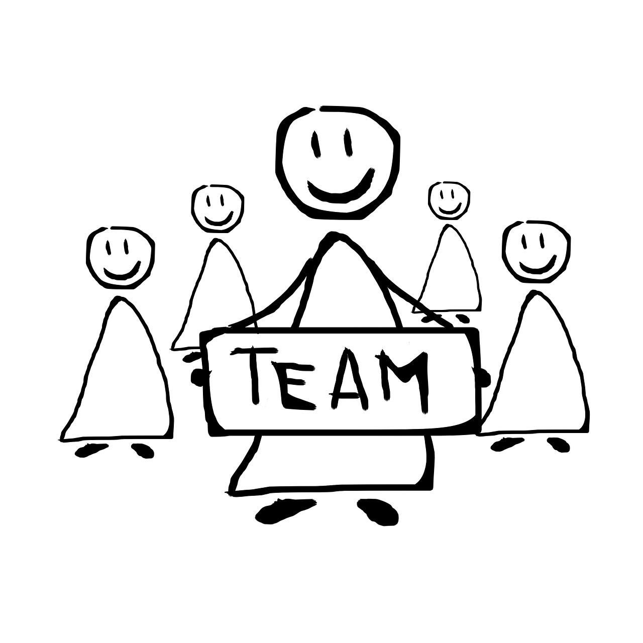
Leading teams can be hard!
Belbin (1993) - team roles model:
Coordinator
Shaper
Plant
Resource investigator
Implementer
Evaluator
Team Worker
Completer/Finishers
Specialist

Slide 15
Leading teams can be hard!
Hackman (2002) proposes three main tasks of a Team Leader :
Create the conditions that enable the team to do its job
Build and maintain the team as a performing unit
Coach and support the team to success

Slide 16
Leading teams can be hard!
Leading through turbulence
Whipping up enthusiasm
Creating a shared ambition
Building and maintaining momentum

Slide 17
Leading teams can be hard!
Using yourself as a leader and agent of change
Awareness of Self – what do I bring to my team leadership role?
Self reflexivity – what could I be adding to the team dynamics?

Slide 18
Getting Teams Working

Slide 19
Getting Teams Working
Four styles of team leadership:
Directive
Achievement-oriented
Supportive
Facilitative

Slide 20
Getting teams working
Making change happen – the difference that can make the difference!
A refreshed vision
What is the change that needs to happen?
Communication, communication, communication…
‘Forming, Storming, Norming, Performing’ (Tuckman, 1965)

Slide 21
Getting teams working
Four stages of Creative Team Problem solving (West, 2012)
Exploration
Ideation
Selection
Implementation

Slide 22
Getting teams working
Thinking about:
Context
Multiple perspectives
Positioning
Making sense of behaviours/actions; including our own

Slide 23
Getting teams working
Planning for change!

Slide 24
Q&A

