Slide 1
Mobile phones and domestic abuse: how mobile phones assist perpetrators in maintaining power and coercive control over current and former partners
Dr Tirion Havard
North London Social Work Teaching Partnership
20th November 2019.

Slide 2
Me and my research.
Senior Lecturer in social work at LSBU.
Qualified social worker .
Practiced as a probation officer, supervising perpetrators of domestic abuse.
PhD from the University of Sussex.
Interviewed women survivors housed in refuges.
I wanted to know if/how mobile phones had influenced their experience of abuse.
Male abusers and women survivors
Names changed to conceal identity.

Slide 3
Structure of this session
Review the literature to understand what is meant by coercive control.
Listen to women’s experiences of how men used mobile phone in their coercive control.
Interpreting women’s responses to coercive control within the context of mobile phone technologies.
Consider the implications of this research for practice.

Slide 4
A theoretical account of coercive control

Slide 6
What is it?
Coercive control is an underlying dynamic that is established and maintained by physical violence (Hamberger et al. 2017; Stark 2010).
Akin to, but different from, emotional violence and should be considered in its own right (Crossman et al. 2016)
Gender asymmetric (Anderson 1997; Crossman and Hardesty, 2017; Dobash & Dobash 1992; Johnson, 2005; Stark 2007).

Slide 7
Emotional abuse
Consequences of emotional abuse is similar or worse than physical violence.
Overcoming the former is more difficult than the latter (Crossman et al. 2016; Follingstad et al. 1990; Seff et al. 2008)
Is likened to PTSD (Arias et al 1999)
Has greater adverse effect than physical abuse in long term relationships (o’Leary 1999)
Emotional abuse indicates a high risk of physical violence in the future (Felson & Messner 2014; Follingstad et al. 1990; Marshall 1996; Straka & Montminy 2008)

Slide 8
French and Raven
First to identify coercive control in relation to social and industrial psychology.
The agent (perpetrator) threatens the target (survivor) with negative consequences if they do not comply with demands.
Purpose is to obtain a desired goal or outcome; in domestic abuse a deliberate intention to control.
Target must believe there will be negative consequences if they fail to conform.
Surveillance (monitoring) is essential to know whether or not the target has complied.
In the case of domestic abuse the survivor must also be in fear.
Notes:
Used French and Raven to take a step back and see if I could identify individual elements that when put together might signpost coercive control and help us identify it. Undesirable consequences can be things the target doesn’t want or withholding things she does want.
I’ll put up some quotes that I hope will demonstrate the various aspects of this, but will chose one or two and explain the background.
Explain that fear is a given since all the women had fled to a refuge for their own safety.

Slide 9
Coercive control in abusive relationships.
Use of various tactics to compel someone to do or not do something (Cook & Goodman, 2006). Perpetrator behaviours are deliberate, pose a credible threat and cause fear in the recipient (Hester, 2013).
A strategic course of conduct in which violence, sexual coercion, intimidation, isolation and control are used to dominate and exploit a partner and deprive her of basic rights and resources. This includes restricting the survivor’s autonomy and freedom, forced economic dependence, isolation from family and friends and undermining the survivor through name calling and diminishing her self-esteem (Crossman et al., 2016; Crossman & Hardesty, 2017: Stark, 2007 Velonis, 2016).
Micro-regulation (Stark 2007) is the control of the everyday actions, thoughts and emotions of the survivor. It can be done overtly or in more clandestine ways and impacts on everyday aspects of a woman’s life.
Coercive control is a condition of entrapment (Stark 2007) that can be hostage-like in the harms it inflicts on dignity, liberty, autonomy and personhood as well as to physical and psychological integrity.
Notes:
Stark is from a feminist perspective and so much of what he says fits nicely and is influenced by the power and control wheel.
Hidden within plain sight.
Drip drip drip effect.
Takes a feminist approach that women are expected (and do) make sacrifices to meet the needs of others, maternity leave, housework etc whereas society deems men to be entitled to respect and submission, can continue to work, better salaries better promotion prospects. These expectations are open to exploitation. As

Slide 10
Who’s reality?
When seen in isolation is not significant “invisible in plain sight” (Stark 2007 p14). Coercive control only becomes an issue to others when seen within a wider context. (Crossman & Hardesty 2017; Hamberger et al. 2017; Stark 2007; Williamson 2010).
Perpetrators create a world that determines the rules and expectations of others, ie they ‘create their own reality’ where the survivor might succumb to an alien will and take on board the abusers reality . The woman believes the perpetrators criticism and her self worth is measured by the perpetrators reactions to her (not by her behaviour). The fear of the consequences of mistakes leaves her paralyzed (Stark 2007; Williamson 2010).
She is left negotiating the ever shifting unreality of the abusers world and the unpredictable rules and boundaries that constantly change. Whatever the woman does is wrong, she can never win, because she has no control over what winning means. (Williamson 2010).
Slowly erodes a woman’s self esteem, respect and confidence until her resistance is worn down. She becomes so undermined she unable to make a decision (Stark 2007; Velonis 2016; Williamson 2010). Anxiety, guilt, depression and fear. Her fear is based on what could happen (Kelly 1998).
Surveillance and monitoring of someone’s behaviour to the extent that it deprives them of their privacy. Creates the impression that the perpetrator is both omnipotent and omnipresent
Women’s independence and autonomy has changed over time, the methods employed by men to control women need to/have changed.
Notes:
Some of these aspects of everyday life are so basic that its difficult to get your head around, eg answering the phone by the third ring, would essentially deprive them of the freedom to go to the toilet with the threat of “or else” hanging over them. They become more infantile and can’t do anything without permission.
Entrapment removes some of the most basic rights uses similar techniques to those seen with hostage taking uses, including an almost brain-washing type. Stockholm type effect seen with abused children too, that they become more attached to the abuser as the abuse escalates. Small acts of kindness promote profound feelings of gratitude and the dynamic changes so the hostages feel that their captors are the ones who are letting them live (not subjecting them to dreadful conditions).

Slide 11
How perpetrators use mobile phones?

Slide 12
Significance
“…. he was controlling me by phone. Everything was by phone…the only reason I have accepted this interview is because I know if you get this message out there it will help a lot of women.” Joanna.
“…. it’s easier, it’s more convenient; it’s smaller, its faster, and I can do it wherever; I could be on a train, I could be walking. You can’t see people walking with a laptop, but you see them walking with their phones like that (holding phone close to face)”. Caprice.
“…and they are just holding it, their phone, in their hand……., it’s like right there, everyday (pause) 24/7 (pause) everyone has their phone in their hand……. because a laptop, you can’t put it in your pocket as easily as you can with a phone. That’ s probably (pause) why mobile phones are such an issue (pause) because you can just walk around with it and whenever you feel like doing something with it you just pull it out and do it and carry on with your day.” Katherine

Slide 13
Texting
Texts were the most commonly used feature in the coercive control of the participants.
“…texting me…a lot, like he text me about 30 texts all at once…just, saying really horrible and degrading things to me”. Katherine
“You are a bitch (Pause) it’s very bad. I can’t tell you [the names he called her] because it is very shame for me.” Francesca.
“If you should look on the phone and look at the messages my husband send to me. If it’s not about sex, sex related videos or something like that, no. If I should text him and say what do you need for dinner?” Peaches
“At one stage I blocked him from texting so what he did was texted me on my landline, so you had this lady with the voice talking: “You are a…” you know? “You are a bitch. I’m going to kill you”. But obviously it’s like a machine talking but reading what he’d texted, which was very freaky.” Caprice.

Slide 14
Voice calls
Caprice’s ex-partner bought their four-year-old daughter the most up-to-date iPhone, allegedly to maintain contact with her. However
“He would call her [daughter] and doesn’t say nothing, and because she’s a child, sometimes because he’s not saying nothing, that’s why she’s constantly just leave the phone [switched on]. This guy could be there all day, the phone will be on, the phone would die, and he will just be there listening to my background, listening”. Caprice
Who, when, where and how long the participants were allowed to speak with their friends was also a common theme.
“I can’t talk too much with friends, when I talk 10 minute he say stop, how long you can talk with your friends, stop.” Francesca.
Notes:
Make the link with patriarchy

Slide 15
Recording
Some men used their phones to gather ‘evidence’ to disguise their abusive behaviour and shift the responsibility onto their partners. Sometimes, unable to cope with the emotional abuse, Indie would beg her husband to stop and let her return home to her parents abroad.
“When I’m crying [he said] ‘why you doing that, why you doing this?’ [pause]. He will [video] record that. He will say ‘I will tell the police that she is mentally upset, and I’ll show this, this is how you cry’…. That is the main thing he was doing throughout, he was telling me, ‘you're mad and you're going off’”. [Indie]
Josephine’s partner would provoke her into arguments and when she reacted, he would voice record the conversation, careful to manage his tone and limit his contribution to the ‘argument’.
“….he would start the quarrel……. Sometimes I talk back at him so it was there to prove that he will record it and then he will, he will send it to them (family). She was angry she was talking like this, she said that she said that. Meanwhile he knows what he was doing so he would try to talk less, or he would try say less.” Josephine.

Slide 16
Photos
Indie’s husband took photographs of his self inflicted injuries as evidence of his abuse by her.
“my ex-partner used to basically just stand outside my house and take pictures and send it to me. Like if I wasn’t at home, he’d send me pictures saying where are you. I’m outside your house?” Katherine.
“……he will just be going through, as if it was his phone, looking at pictures…” Peaches.
“[If] I’m taking pictures or anything all the time he taking, deleting all the pictures for his computer so I can have more memory, but I don’t want to, but he did this… that's the thing, he didn’t deleting, he’s swapping he just change everything”. Matilda
Notes:
Notice patriarchial attitudes as if he has a right to her phone. Married Woman’s property Act
Abusive men saw their partner’s mobile phone (and the information contained within it) as something that belonged to them; something that they had a right or even a duty to check. This was reminiscent of the UK Married Woman’s Property Act 1870, where a wife was deemed to be her husband’s property and everything she owned (her children, her estate etc.) belonged to him

Slide 17
Social Media
Perpetrators would use social media to abuse the women directly and through friends and family.
“He would always send me pictures, not very nice pictures on Instagram and he would just direct message me them, just so that I could just see them” Katherine.
“he got that restraining order, so he ask his son to send me a request via Facebook, a friend request. I know his son, .……. I know that he would never do something like that on his own, he must be advised by his dad to do this”. Donna

Slide 18
Tracking
Police moved Donna and her child into B&B accommodation for their safety. When her young daughter turned on her tablet, as she had done hundreds of times before, Donna was surprised to find an alert saying that the iPad was stolen. She contacted the police who explained that
“…when you report.…an iPhone or iPad is stolen, the Apple store they localize the iPad, ……the email was been sent to him with the address of the B&B, yeah, where I was. Where the iPad is.” Donna.
GPS tracking was also very common
“He would track where I’d been and what I’d been doing, because you can do that with the mobile phone these days….. tracking me all the time. Wherever I went [pause] and in the end, like I said, I never went anywhere, I was just housebound unless he said I could go out” Suzie.

Slide 19
It’s hard to stop the abuse.
Changing mobile phones or blocking numbers was common but perpetrators
Created fake profiles on social media.
Set up fake profiles on dating sites and arranging to meet the survivor.
Sending abusive messages to landline.
Reporting iPhone stolen to the Apple store.
Getting family and friends to get in contact via social media, text, calls.
Target friends phone eg bombarding them with questions/calls. Making them uncomfortable.
“And if it’s not his account that he’s looking from, because I’ve blocked him, he’ll be looking from someone else’s account. So, he’ll still know where I am, what I’m doing …yeah it’s just really hard to find a way …to …shut him out completely.” Katherine.

Slide 20
Surveillance
Men used mobile phone for constant surveillance leaving their partners feeling controlled.
“…..constantly I felt controlled. Even when I was out, I was controlled because he would control me by texting me, not just, not just calling me on my phone, he would call me on my phone, text me on my’ (pause) ymmm (pause) message, what’s app me, you see? Facebook me, so it was literally four different places. So (counting on her fingers) phone calls, texts, WhatsApp ,Facebook, that’s four.” Joanna.
Surveillance could be overt or covert. This is echoed in other studies in the US and in Australia.
“Even though I never saw him doing it the things he would say after, “Who called you at twelve? on an unknown number?” He would question me about anything and he’d ask me, “I’ve told you not to be on the phone after hours….after ten o’clock in the evening; no one should be calling your phone”. Caprice
I had a Facebook working on my phone and he had my Facebook on his phone as well just to check who I was talking to , what I’m positing, everything. I had no freedom.” Joanna.
The surveillance afforded by mobile phones left many of the women feeling like they could be seen anytime, all the time. The constant surveillance became a powerful means to keep the women subservient.

Slide 21
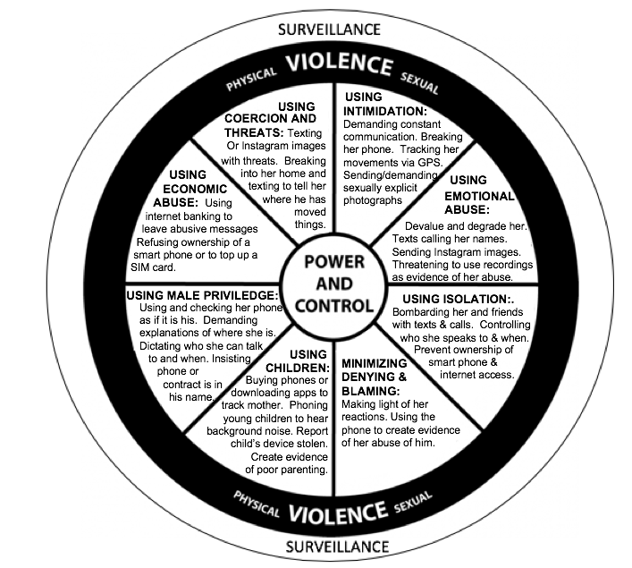

Slide 22
Understanding Survivors’ responses.

Slide 23
The mobile phone
Women who had experienced domestic violence both before and after the advent of mobile phones said abuse was much worse with the mobile phone.
Women commented on the accessibility of mobile phones.
Mobile phone’s are a gateway to other forms of communication such as social media.
Social media can then be exploited to further harass/threaten/coerce the women.
“I think I would feel less trapped (without mobile phones), just not as much, due to the fact that if there were no mobile phones people wouldn’t be able to access the social media on their phones and stuff. You wouldn’t be able to communicate with me, email me so easily, so freely, how you please ……. I felt I was stuck I felt there was no getaway. I felt my only getaway was to die, because he made me feel like that ” Caprice.

Slide 24
Fear
Peaches went to visit relatives when her husband was abroad, they were keen that he did not know their new address and so, when her husband rang, Peaches pretended to be at the cousin’s old home. After hanging up, Peaches’ husband sent her a message with her exact location, including a picture of the new house, thus exposing Peaches’ lies during the call.
“…by the time I was done talking and everything he sent me this map (pause) and when I click on it, it showed me the exact point that I was. I was in {name of road} and it shows me the exact house, the street everything and that I was at {name of the road} [pause]….” Peaches

Slide 25
Entrapment
The impact of the monitoring, control and abuse was cumulative and left the women feeling powerless, exposed and trapped.
Indie, came to UK alone, made friends and obtained a post-graduate degree.
“..because I was under big stress and I couldn’t do anything like, I couldn’t think about, I couldn’t think. I was just helpless…. “ Indie.
“It’s really hard [pause] to like [pause] hide yourself basically, so he could do anything, he could put a picture [on social media] to say I’m missing and then people will start ringing his phone saying, “oh I saw her here, I saw her there”. Katherine.

Slide 26
Alien will (Stark 2007).
In an effort to mange the abuse, women in this study changed their behaviour and behaved in ways that they believed will please (or at least not anger) the perpetrator.
Suzie described herself as once “gregarious”, a former landlady who thrived off other people’s company. She adopted an ‘alien will’ to mange the repeated arguments and constant surveillance. Her demeanour changed as her confidence and self-esteem plummeted and she became passive and unresponsive.
“ sometimes I would just leave it [confrontation] and I got so withdrawn into myself that every conversation that we would have was an argument so I would just sit there, and I wouldn’t talk. I would just sit there and watch TV….” Suzie.

Slide 27
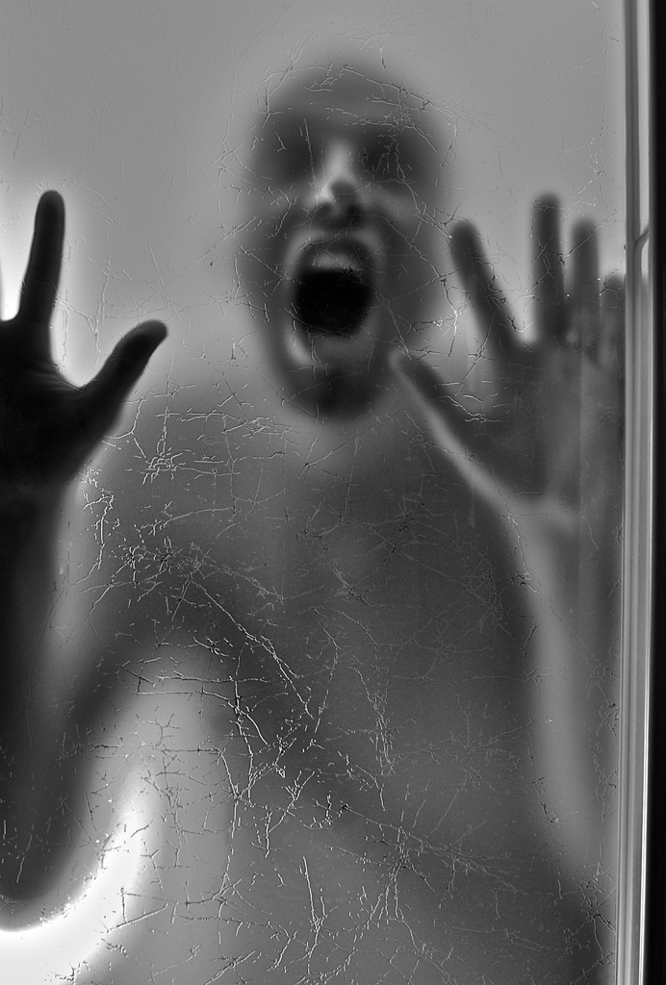
Who’s reality?
Women were unclear why they were being monitored and the system establishing their guilt was never made clear. This reminded me of Kafka’s “The Trial”.
“Even if I’m not lying, immediately I’m a liar because I didn’t answer the video call, to show him and he would use that video calling a lot.” Joanna
“….it’s like I’m hiding something, and he wants to know what I’m hiding. I’m not hiding anything, I want to go out ….” Donna.
Indie was afraid that her partner’s videos of her breaking down would result in her losing access to her children. It had not occurred to her that they might show the impact of his abuse and actually support Indie’s account that he was the perpetrator. Had Indie entered the man’s reality, part of which was the unquestioning acceptance that those in authority would unconditionally believe his account?

Slide 28
Bentham and Foucault

Slide 29
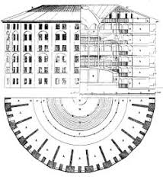
Bentham’s Panopticon
In the centre of a prison, there is a guard tower from where all the prisoners are visible at all times.
The walls between each cell separate the prisoners ensuring isolation from other inmates.
The prisoners are only able to see the guard tower (not the guard within it). This serves as a constant reminder that they are permanently being watched and monitored.

Slide 30
Surveillance: a mechanism of control
Prisoners don’t know when/whether they are being watched.
Prisoners behave as though they are always being watched (self surveillance).
Rules, procedures and regulations are used to control people. Violence is not required.
They become their own goaler and eventually no locks or bars are needed.
With mobile phones, perpetrators become the guards, mobile phones the tower and the prison is beyond geographical boundaries.

Slide 31
Omnipotence.
Because of mobile phones, men had 24/7 access to women. This created a sense of perpetrator omnipotence. Women felt constantly and permanently visible with many believing that they were being watched even when this was not possible.
“Everywhere I go I would look behind me to see if he’s there or if I’m with my friends and we were doing something silly, you know going out for a drink or anything, I became paranoid because he was checking my ev-ry move, every move... “ Joanna
“I wouldn’t go places, because I know he would find me [pause] If I went to meet somebody [pause] if I turned the location off he would know where I am, he would track my phone.” Suzie.
This effect could last for years. More than two years after her last contact with the perpetrator Donna still
“… put tissue (covering the lens of the camera). I don’t know but in my mind, I think maybe he can see over the (pause) I know, it is a sickness, but I put it and I glue it so he can’t see [laughs]”. Donna.
Notes:
Coercive control is a condition of entrapment that can be hostage-like in the harms it inflicts on dignity, liberty, autonomy and personhood as well as to physical and psychological integrity
Matilda: impacted on her personhood. Before Matilda married she would speak to her friend every day, often for hours.
Josephine: impact on her dignity, he only spoke with her to insult her. Also the same with Indie.
Suzie: clearly impacted on her liberty and autonomy as she didn’t go places she wanted to go.

Slide 32
Self-surveillance
Survivors’ behaviour changed (alien will) even when the perpetrator’s were not present.
“….my behaviour would change because I wouldn’t go places, I made sure it was places he would approve of me going.” Suzie
They began to predict what the perpetrators wanted and conformed without being asked.
“Sometimes I stuck in traffic and film everything and photo everything when I am stuck in traffic because he does not trust me.” Francesca
Ultimately nothing the women said or did was enough.

Slide 33
Resistance
All the women in this research resisted the abuse at some point. Not ‘passive victims’
They all left the relationships and went to a refuge.
Defying their partner eg not answering their calls, going out with friends. Knowing they would have to ‘answer for it later.’
Took a knife to her partner (violent resistance)
Criminal prosecutions.
‘Enough is enough’.

Slide 34
Implications for practice.

Slide 35
How can we use this knowledge?
Use mobile phones to provide a context for the abuse so that it is not ‘hidden in plain sight’
Professionals actively question how mobile phones are being used in domestic violence situations.
Who provided the mobile phone? Check what apps might have been downloaded onto the survivors’ phone.
Multi-agency working –to compare perpetrator and survivor's accounts of how the phone is/was being used by the perpetrator. If and what attempts the perpetrator has made to overcome the survivor’s efforts to avoid contact and sharing this information.
How photographs might be used to establish the survivor’s whereabouts, company etc.

Slide 36
Working with the perpetrator
Helps to focus on perpetrator behaviour. What has he done in terms of monitoring and control?
Consider how the perpetrators use of the mobile phone with the survivor compares to others in his/her peer group. Hold him accountable.
Provides opportunities to highlight perpetrator choices to be abusive and controlling.

Slide 37
Working with the survivor
How has perpetrator used mobile phone? How has this impacted on survivor's daily routine? Can we use this to help her see that the abuse is not her fault? Re-create her reality?
How did survivor manage this? Opportunity to introduce a strengths based approach.
Use mobile phone as strategy to manage/keep record of the abuse. Help build trusting relationships.

Slide 38
References

Slide 39
References.
Anderson, K. 1997 Gender, status, and domestic violence: An integration of feminist and family violence approaches, Journal of Marriage and the Family, 59(3), pp. 655–669.
Crossman, K.A., Hardesty, J.L. & Raffaelli, M., 2016. “He Could Scare Me Without Laying a Hand on Me.” Violence Against Women, 22(4), pp.454–473.
Crossman, K. A. and Hardesty, J. L. 2017 Placing Coercive Control at the Center : What Are the Processes of Coercive Control and What Makes Control Coercive ?, Psychology of violence, 7(1), pp. 1–11.
Dobash, R.P., Dobash, R.E., W. M. and D. M. (1992) The myth of sexual symmetry in marital violence, Social Problems, 39(1), pp. 71–91.
Felson, R.B. & Messner, S.F., 2014. Violence * The Control Motive in Intimate Partner. Social psychology quarterly, 63(1), pp.86–94.
Follingstad, D.R. et al., 1990. The role of emotional abuse in physically abusive relationships. Journal of Family Violence, 5(2), pp.107–120.
French, J. R. P., Jr., & Raven, B. (1959). The bases of social power, in Cartwright D. (ed.) Studies in Social Power. University of Michigan, Research Center for Group Dynamics, Institute for Social Research, pp. 150–167.
Hamberger, L.K., Larsen, S.E. & Lehrner, A., 2017. Coercive control in intimate partner violence. Aggression and Violent Behavior, 37(February), pp.1–11.
Hester, M., Jones, C., Williamson, E., Fahmy, E. and Feder, G. 2017 Is It Coercive Controlling Violence ? A Cross-Sectional Domestic Violence and Abuse Survey of Men Attending General Practice in England, Psychology of Violence, 7(3), pp. 417–427

Slide 40
References
Johnson, M. P. 2005 Domestic Violence : It ’s Not About Gender — Or Is It? , Journal of Family Violence, 67(December), pp. 1126–1130.
Kelly, L. (1988) Surviving sexual violence. Cambridge. Polity Press.
Nevala, S., 2017. Coercive Control and Its Impact on Intimate Partner Violence Through the Lens of an EU-Wide Survey on Violence Against Women. Journal of Interpersonal Violence, 32(12), pp.1792–1820..
O’Leary, K., 1999. Developmental and affective issues in assessing and treating partner aggression. Clinical Psychology: Science and Practice, 6(4), pp.400–414.
Seff, L., Beaulaurier, R. & Newman, F., 2008. Nonphysical Abuse: Findings in Domestic Violence Against Older Women Study. Journal of Emotional Abuse, 8(3), pp.355–374.
Stark E., 2007. Coercive control, how men entrap women in personal life. New York. Oxford university press.
Straka, S. & Montminy, L., 2008. Family Violence: Through the Lens of Power and Control. Journal of Emotional Abuse, 8(3), pp.255–279.
Velonis, A.J., 2016. “He Never Did Anything You Typically Think of as Abuse”: Experiences With Violence in Controlling and Non-Controlling Relationships in a Non-Agency Sample of Women. Violence Against Women, 22(9), pp.1031–1054.
Williamson, E., 2010. Living in the world of the domestic violence perpetrator: negotiating the unreality of coercive control. Violence against women, 16(12), pp.1412–1423.

Slide 41
Thank you.
If you want to contact me;
Email: havardt@lsbu.ac.uk
@tirionhavard.
any thoughts, ideas or questions?

