Slide 1
SKEF: Exploring Gang Culture, Criminal Exploitation, Vulnerability and Violence
2nd July 2019
PS David Finnegan
Metropolitan Police
Simone Nyarko - Practice Development Manager and Training and Development Lead
Kayleigh Broughton - Social Worker and Co-Lead for Training and Development
Hackney Contextual Safeguarding Project

Slide 2
Session objectives:
Understand what may make a young person or vulnerable adult more susceptible to exploitation
Participants to consider early warning signs that social work staff should be aware of in child protection work
Participants will consider what is needed from services to respond effectively to criminal exploitation and aid recovery

Slide 3
Introductory Quiz:
How long can a Police Officer keep a child in Police Protection?
48 Hours
72 Hours
As long as necessary
What is the lowest rank that can make the decision to take a child into Police Protection?
PC
Inspector
Chief Inspector

Slide 4
Introductory Quiz:
When someone is arrested where does the law state they should be brought to?
A Purpose Built Custody Suite
A Designated Police Station
Any suitable place
What is the lowest rank that the law states can decide to detain someone at a Police Station after arrest?
PC
Sergeant
Inspector

Slide 5
Introductory Quiz:
Approximately how many County Lines do the NCA state are currently active across England & Wales?
320
510
720
How many of those are estimated to be running from London?
113
283
396

Slide 6
Introductory Quiz:
Who is responsible for investigating a Missing Person Report of a LAC moved away from the area to somewhere else in London?
BCU where they now live
BCU where they have been moved from
Co-ordinated approach from both BCU’s
What department is responsible for investigating Low and Medium Risk Missing Persons for the first 48 hours?
Missing Persons Unit
Emergency Response Team
No investigation takes place until Missing for 48 hours

Slide 7
Introductory Quiz:
How long can a Police Officer keep a child in Police Protection?
48 Hours
72 Hours
As long as necessary
What is the lowest rank that can make the decision to take a child into Police Protection?
PC
Inspector
Chief Inspector

Slide 8
Introductory Quiz:
When someone is arrested where does the law state they should be brought to?
A Purpose Built Custody Suite
A Designated Police Station
Any suitable place
What is the lowest rank that the law states can decide to detain someone at a Police Station after arrest?
PC
Sergeant
Inspector

Slide 9
Introductory Quiz:
Who is responsible for investigating a Missing Person Report of a LAC moved away from the area to somewhere else in London?
BCU where they now live
BCU where they have been moved from
Co-ordinated approach from both BCU’s
What department is responsible for investigating Low and Medium Risk Missing Persons for the first 48 hours?
Missing Persons Unit
Emergency Response Team
No investigation takes place until Missing for 48 hours

Slide 10
County Lines
DEFINITION:
“A system used by criminals based in cities to supply drugs in smaller towns & rural areas.”
Name used refers to a single phone line used by a particular gang.
Organisers operate from a distance outside the affected area using vulnerable people to deliver drugs and move money.
Usually the lines are re-supplied from their home area.

Slide 11
Why Have They Developed
MPS have developed an extensive Gangs Strategy and most significant members of the Gangs have been identified
County Forces are still developing these strategies due to it being a new issue
Numbers of officers in County Forces do not match the MPS
Staging areas have been created through re-housing
Risk to their business is greatly reduced, easier to move around and increases their client base
Altercations with rival gangs are avoided

Slide 12
Break - 10 minutes

Slide 13
Background - DfE Innovation Bid
Hackney awarded DfE innovation bid to develop a Contextual Safeguarding approach.
Two year project in partnership with the University of Bedfordshire (UoB)
Supported through a ‘Contextual Safeguarding’ project team including Hackney staff and researchers from the UoB.
Aim to develop interventions to identify and intervene with extra-familial risks, working with the wider context in which these risks arise.

Slide 14
Theoretical framework: Bourdieu
https://www.contextualsafeguarding.org.uk/audit-toolkit/introduction/theoretical-underpinning

Slide 15
The Scale of Peer-on-Peer Abuse
1/3 identified cases in England and Wales, 55% in London
Recorded cases of children committing sexual offences against other children have risen by 78% in England and Wales between 2013 and 2016 (Barnardo’s, 2017)
When surveyed, a quarter of girls and 18% of boys report experience some kind of physical violence from a partner (Barter, et al., 2009)
Between 30 and 70% of young women report encountering sexual harassment in school (EVAW, 2010; GirlGuiding UK, 2014)
10-15 year olds in 2013 were estimated to have experienced 465,000 incidents of violent crime, 79% of which had been perpetrated by someone also aged 10-15 (ONS, 2015)
A survey of adult survivors of child sexual abuse in England in Wales in 2011 founds that around two thirds had been abused by a young person and not an adult (Radford, et al., 2011).

Slide 16
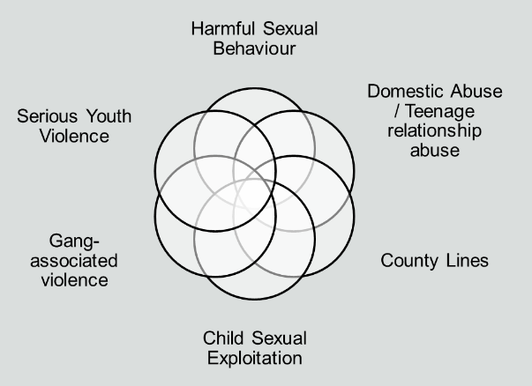
Defining Peer-on-Peer abuse
Physical, sexual, emotional and financial abuse, and coercive control, exercised within young people’s relationships

Slide 17
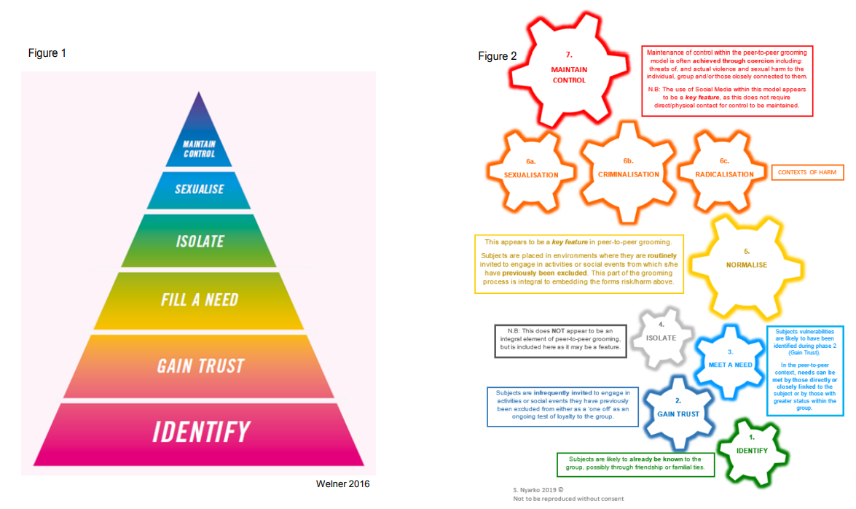
Notes:
Speaker Notes:
Figure 1, depicts the Grooming Triangle used by Barnardo’s in their practitioner resources and adapted from Dr Welner, 2013. The triangle is used to describe 6 stages of grooming within the context of Child Sexual Exploitation which can be undertaken by a solo perpetrator to secure and control a victim in order to cause sexual harm.
Whilst this model has proved useful in terms of understanding the grooming process for individual’s perpetrators of sexual harm, the model to the right has been designed to help practitioners identify and understand the grooming process within a group context or with multiple perpetrators of harm. This may be in order to facilitate sexual harm through Child Sexual Exploitation, but may also be used to understand peer-to-peer grooming into Radicalisation and Criminal Exploitation.
Resources: A4 Colour print of Figure 2.

Slide 18
Notes:
Speaker Notes:
As per Welner 6 stage model, the first and subsequent two features within the peer-to-peer grooming model: Identify, Gain Trust and Meet a Need remain static, however in this new model offers practitioners (and those who work with young people groomed within a group context) alternative explanations for these features. In particular it is noted that the subjects are ‘likely to already been known to the group…. through friendship or familial ties’.
This may add an additional complication when working with peer-to-peer grooming, as language currently widely used such as victim and perpetrator become less useful within this context. In addition, practitioners need to be mindful when working with young people groomed within a context of familial ties, that these factors and belief systems are likely to be intergenerational which may make any harmful attitudes and narratives more difficult to interrupt.
Practitioners working with intergenerational grooming should consider how to dovetail work to manage both intra-familial harm and the risk posed to young people within a group setting.

Slide 19
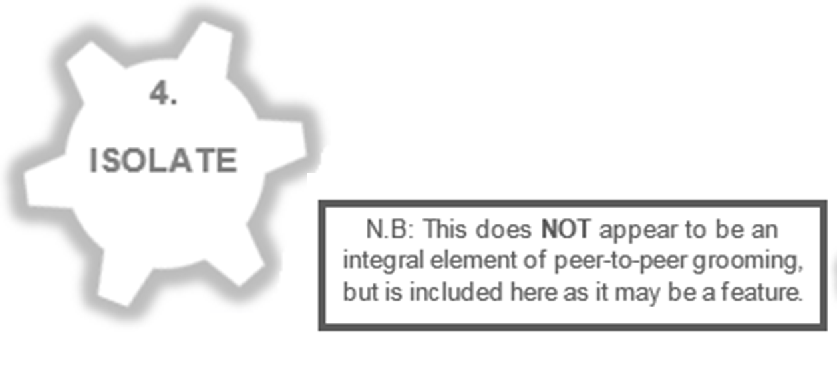
Notes:
Speakers Notes:
Whilst the Barnardo's model for children groomed into sexual exploitation suggests that isolation is a key factor in grooming, with the peer-to-peer model, this does not have to be present in order for grooming to occur.
Young people groomed within a group context may not be isolated from protective networks, instead these may co-exist independent of one other. This may explain why some parents/carers only find out about the grooming their child has experienced outside of their home setting at arrest because social norms within the household are adhered to.
This said, it must be acknowledged that at times young people groomed within a group context may be encouraged and even required to sever protective contacts with family and friends and that is almost all cases those who groom assume a pseudo-protective and understanding position.

Slide 20
Notes:
Speakers Notes:
The Peer-to-Peer grooming model identifies an alternative and new 5th phase in the Grooming process. This is the stage of Normalisation of harm.
Within this 5th stage, those who seek to encourage young people into harmful or exploitative circumstances, routinely invited to engage in activities or social events from which s/he have previously been excluded. This part of the grooming process appears to be more powerful and effective if the subjects have been groomed using Isolation (stage 4).
Practitioners should be worried not only about young people who groom other young people into exploitative situations, but must also be concerned with professional systems and services that contribute to the normalisation of the experience of harm. This is most aptly illustrated by the placement of multiple young people in alternative education provision. In this environment, vulnerable young people are connected by the location of, and their right to receive education. However it is of note and of concern that young people who either may not be known to each-other or maybe part of an excluded cohort of young people from a mainstream setting, can begin to exploit or be exploited together.
Similarly, and as per the theory used to underpin the contextual approach to safeguarding; in the event young people are exposed to harmful social norms including HSB and weapon carrying – they are likely to adopt these in order to keep themselves safe from harm and gain status. These locations should be given priority status for contextual interventions when harm is identified.
Another complication with the normalisation of harm experienced by young people appears to be the lack of an appropriate response to this from services. Practitioners managing cases where extra-familial harm is a factor must be closely supervised and supported to keep the levels of risk posed to the subjects at the forefront of any plan or intervention. There is a real risk that practitioners themselves begin to normalise and therefore minimise harm to young people . This means that the very services supposed to protect and safeguard them are in danger of normalising the harm they experience and therefore are likely to leave young people with the belief that they are either responsible for the harm they are subjected to and/or that they should be able to extricate themselves from harmful situations. This facilitates harm continuing or reoccuring.

Slide 21
Notes:
Speakers Notes:
This model is being developed to support practitioner understand behaviours of young people who experience peer-to-peer grooming. It is considered particularly useful when thinking about young people groomed into criminality by their friends, associates or family members. This said, it is also thought to assist when thinking about group grooming into other forms of exploitation, including CSE and Radicalisation.
We would like to here your feedback about the application and use within these contexts of harm.

Slide 22
Break - 10 minutes

Slide 23
Seeing the signs…
Consistently being reported missing
Distrust of authorities or acting as if instructed by someone else
Stopped by other police forces some distance away from their home area
Appear to not know the local area when questioned
Expressions of fear/anxiety and/or lack of medical care
In possession of train tickets/burner phones/addresses/phone numbers
Injuries resulting from assault or controlling measures
Gang members that have been moved appearing back in the London area
Passport or other documents being held by someone else
Someone else buying their food for them on a regular basis as payment
Identifying factors from other investigations

Slide 24
Seeing the signs….
Parental concerns
Regularly going missing from school or home and / or being found out-of-area
Unexplained money, clothes, or mobile phones
Threatening to harm self or others in the home if prevented from leaving
Excessive receipt of texts / phone calls
Relationships with controlling / older individuals or groups
Leaving home / care without explanation.
Suspicion of physical assault / unexplained injuries
Carrying weapons
Significant decline in school results / performance and attendance
Gang association or isolation from peers or social networks
Self-harm or significant changes in emotional well-being

Slide 25
Quality Assurance: Challenging Language
Promiscuous
Manipulative
Streetwise
Risky choices/behaviour
Lifestyle choices
Putting themselves at risk
Absconder
Sexually aware / experienced
Not safeguarding her/himself
Unfaithful
Aggressive
Out of control
Liar
Boys being boys
Glamour
Will not engage

Slide 26
Suspect vs Victim
Drug Dealers use vulnerable children/adults to protect themselves
Creates a hard choice between treating them as a suspect or as a victim
Defence of Duress and the follow on problems
CPS Direction that Police should take a more balanced approach
“Instead of immediate disposal, the child/vulnerable person should be bailed/RUI so more information can be sought from partner agencies as unlikely to have this information while they are in custody”

Slide 27
Victim vs. Perpetrator
Narrative from a child protection social work perspective

Slide 28
Modern Slavery
Modern Slavery Act 2015 (MSA) – 3 Main Offences (Repeals Other Law)
Slavery, Servitude and Forced or Compulsory Labour
Human Trafficking for Purpose of Exploitation
Committing an Act with Intent to Commit the Offence of Human Trafficking (False Documents/Transporting People)
Where there is indications on HT, Police should record a crime report and also make a referral to the NCA via the National Referral Mechanism (NRM)
Over 18 – Must have their consent Under 18 – No consent is needed
“Where a decision is made to charge offenders for drug offences, it is very difficult to reverse that decision in order to bring Human Trafficking charges against real offenders” CPS

Slide 29
Modern Slavery
S.45 MSA 2015 – Defence when compelled to commit the crime
If you BELIEVE they are a victim of modern slavery – More than suspicion
Should be released immediately and safeguarding measures implemented
Over/Under 18 is irrelevant just that they committed the offence and it was a DIRECT consequence of them being a victim of trafficking or slavery.
Opportunity to stop the act and get help
Balance of Probability Test not Beyond Reasonable Doubt Test
Once classed as a victim, no requirement to then give evidence.

Slide 30
Modern Slavery
S.45 MSA 2015 – Defence when compelled to commit the crime
Certain Offences this does not apply to
False Imprisonment/Kidnapping
Murder/Manslaughter
Serious Assaults
Firearms Offences
Robbery/Burglary
Perverting the Course of Justice
Piracy
Other Offences listed in Schedule 4 of the Act

Slide 31
Modern Slavery Conviction
Operation Lindvi – March 2017
County Line identified operating between London and Swansea
Joint operation with South Wales Police identified the address being used
During the search a vulnerable 19 year old woman was found who had been reported missing from her home in London
Driven to Wales and her phone destroyed – Told ‘You belong to me now’
Held at the address for 5 days and forced to hold drugs and deal for them
Police proved that two men were running this operation and had trafficked the woman to the area in order to exploit her
Both pleaded guilty to the offence at Court and were sentenced
ONLY REASON THE COURT CASE WENT AHEAD WAS DUE TO THE VICTIM SUPPORTING THE PROSECUTION.

Slide 32
Seeing the Signs - Case Studies
Notes:
SN
Adaption from Child Protection Conferences;
Consideration for the existing framework used in Hackney - needs to reflect the existing framework for Hackney's Child Protection conferences and follow how assessments are conducted - ie use a hybrid of Signs of Safety model and a strengthening families approach to consider / record areas of risks, strengths, grey areas, (need more information) and complicating factors.
Wanted SWs and professionals to feel comfortable with the framework - in identifying risk etc, but also in the Conference itself, given all the other differences.
* Terms of Reference;
based of ToR for the existing MAP meetings. Sent to all invitees, along with the assessment, includes the Working Together amended guidance as well as the aims of the conference:
- to bring together a multi agency group of key stakeholders, within a statutory child protection framework, to consider the assessment of extra-familial contexts.
- to consider interventions to address risk and build upon the strengths identified, to be tasked to and delivered by Children's social care and partner agencies.
- to share intelligence, data analysis and current interventions already in place; define priority areas to respond to risks, build on strengths and intervene effectively with peers, groups,schools and public space
- the need for a meeting akin to a CP Conference which is on a statutory footing, but the current CP Process not being set up to effectively respond to extra-familial risk due to focus upon parenting capacity and need to include new multi-agency partners who are stakeholders who are in a position to create change in a context
- multi-agency buy in from non traditional partner agencies is an issue to consider

Slide 33
Case Studies
Approaching Young People in the Area
Territory and Historical Gang Areas
Creating Drug Debts
Planned Deliveries and Robberies
Identifying Family and Home Addresses
Sending Messages through Family Members
Organised Drug Drop Deliveries
Dead Drops
Tasking Younger Members/Initiation Acts
Identifying Other Dealers and Attacking Them

Slide 34
Family history and background
Paul Jnr is 16
Laila, Paul’s mother is parenting alone after the parents relationship of 17 years broke down a year ago. There have been reports of continuous arguing about co-parenting, finances and housing. Both parents deny domestic abuse.
Paul has a relationship with his father Paul Snr and he sees him once a week at the weekend.
Notes:
KB

Slide 35
Home Life
Paul, age 16 -
Paul previously had a good relationship with his mother, but of late he has become rude and frequently tells her that he does not need to listen to her rules and that he will be moving out soon because he is 16 and she cannot tell him what to do.
Paul has put a lock on his bedroom door several times; he says that this is to stop his siblings going into his room and through his stuff. Mother has removed it, but each time he puts it back.
Paul has started to stay out after his curfew, he is being brought home in cars and has also been returned home by the police after being found in possession of a knife on two occasions. He was referred to Prevention and Diversion after admitting the first offence but received a Referral Order for the second offence, which is nearing completion. Although he did not attend all of his appointments he has developed a good relationship with his Youth Offending Team worker. Paul has been warned that a further offence is likely to result in a custodial sentence.
Last week Paul was out for four nights. On the first night mum called him and he answered the phone, saying he was staying at his friend’s house. When mum asked to speak to the adult in the home the call was disconnected and she was not able to get back in touch with him. Mum called the Police but they advised that he was not missing as she had spoken to him. Paul returned home on the fifth evening at 10pm. He told mum that his battery had died and they argued. Mum has told you that Paul’s response was more aggressive than usual and she thought he might hit her but he did not.
Notes:
MN

Slide 36
Education
Paul, age 16 -
Paul has had difficulties with his behaviour in school from a young age. When he was in primary school his mother was often called in to calm him down or asked to come and collect him due to him hitting teachers and other children.
Paul’s difficulties persisted in secondary school. Individual pastoral staff have offered his parents a sympathetic ear about his behaviour and some staff had expressed to his mum that they are worried about how the school had been managing him.
The school had offered counselling which Paul had started to attend, however, this ended when he was permanently excluded following the first knife incident. He now is on roll at the Pupil Referral Unit but only has lessons three days a week. Paul sometimes skips days at his education provision.
Notes:
KB

Slide 37
Neighbourhood
Laila, mother -
Laila and her family have lived in the same neighbourhood since she was a teenager and moved out of her parents home, but remained living locally.
Laila has a good set of friends who support her.
Laila also went to the local secondary school.
Notes:
KB

Slide 38
Neighbourhood (cont.)
Paul, age 16 -
Laila has told you the one of her friends has informed her that she has seen Paul hanging out on the street with older boys at whilst she is at work.
Mum has not been particularly worried about this as some of the children she has seen him with are the sons of her friends.
Mum does not know some of the males in the group
Notes:
KB

Slide 39
The Incident
Laila calls you to update that Paul has just left the house after she overheard him on the phone saying that he is going to “deal with it”.
Laila says that she asked him what he was talking about but he refused to say. Laila tried to prevent him from leaving by standing in front of the door but he pushed her out of the way.
Laila saw him get into a car that appeared to have been waiting for him outside.
Laila is calling because e is worried because she suspects Paul has removed a knife from the kitchen.
Paul is currently not at home. Mum spoke to him this afternoon and he said he would be staying at a friend’s. He is not currently answering mum’s calls.
Notes:
KB
Neurological and social considerations

Slide 40
Discussion
1. What are the risks?
2. What would you do?
3. Who would you ask for help?
4. At what point could / should someone have intervened earlier?
5. How can services consider recovery in our responses?
Notes:
MN

Slide 41
Q&A

Slide 42
For more information
Contact the project team at: Contextual.safeguarding@hackney.gov.uk
Join the Contextual Safeguarding network at: www.contextualsafeguarding.org.uk
Contact PS David Finnegan at:
david.finnegan@met.pnn.police.uk

